Slide 1
DATABASE
NoSQL
Daniela Betancourt Agudelo
Yerson Andres Ramirez
Walter Marmolejo Diaz

Slide 2
INTRODUCTION
alking about NoSQL databases is talking about structures that allow us to store much more information, in those situations they generated certain problems mainly to problems of scalability and performance of the related databases where thousands of concurrent users come together and with millions of queries daily
NoSQL
DATABASE

Slide 3
Definition
NoSQL
NoSQL databases arise from the need to store large volumes of information, with the arrival of applications such as Facebook, Twitter or YouTube, any user could upload content, thus causing an exponential growth of data.

Slide 4
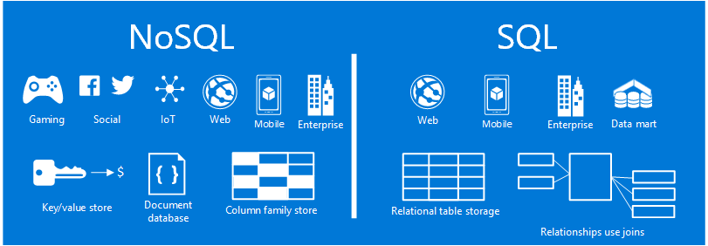
ADVANTAGE
NoSQL database
This way of storing information offers certain advantages over relational models.
Among the most significant advantages we can highlight are:
They run on machines with few resources.
Horizontal scalability.
They can handle a lot of data.
It does not generate bottlenecks.

Slide 5

DISADVANTAGES
NoSQL database
NoSQL databases being open source have a different support than the commercial companies offer to their products.
They are not mature enough for some companies.
The lack of experience.
Compatibility problems

Slide 6

MAIN DIFFERENCES WITH SQL DATABASES
Some more outstanding differences are:
They do not use SQL as a query language
They do not use fixed structures as tables for the storage of data
They do not usually allow JOIN operations
Distributed architecture

Slide 7
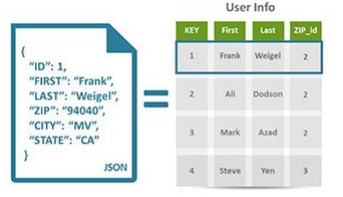
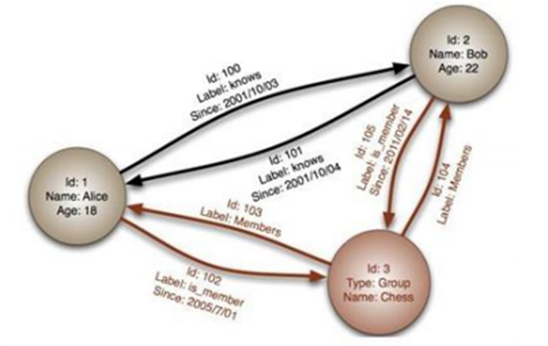
TYPES OF DATABASE NoSQL
Bases de datos documentales
Bases de datos en grafo

Slide 8
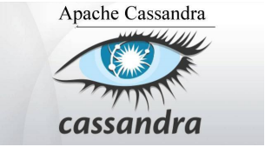



NOSQL MOST USED DATABASE
CASSANDRA
REDIS
MONGODB
COUCHDB

Slide 9

LARGE COMPANIES THAT USE THIS TYPE OF DATABASES
There are many large companies that make use of this type of non-relational databases, such as:
Cassandra: Facebook, Twitter
HBase: Yahoo, Adobe
Redis: Flickr, Instagram, Github
Neo4j: Infojobs
MongoDB: FourSquare, SourceForge, CERN

